Slide 1
An Intelligent Skin Disease Diagnosis Application
Supervisor: Prof. Iyad Jafar
Author(s) :
Fatima Al Zahra’a Ghazal Hadeel Adas
Date :26 /5 /2024

Slide 2
Introduction
Importance of Skin:
Largest organ, vital for protection and interaction with the environment.
Challenges:
Susceptible to conditions, difficult early detection, and lack of access to specialized care

Slide 3
Problem Definition
Early Detection Issues:
Difficulties in early diagnosis and management of skin diseases.
Access to Care:
Limited access to specialized dermatological care and systemic barriers to timely diagnosis.

Slide 4
Proposed Solution
Mobile Application: AI-powered app for quick and accurate preliminary diagnoses.
Features:
- Image capture and AI analysis.
- Confidence levels and WHO information.
- Geolocation-based clinic recommendations.
- Dermatologist validation.
- Voluntary data contribution.

Slide 5
Project Impacts
Economic Impact: Cost savings in healthcare, reduction in treatment costs by preventing disease progression.
Societal Impact: Empowerment through health information, promotion of health literacy.
Public Health Impact: Prevention of infectious skin disease spread, support for public health initiatives.

Slide 6
Related Work
DermEngine: Secure image sharing for dermatologists, lacks AI-driven diagnosis.
VisualDX: Extensive medical image library, not tailored for patient use.
Model Dermatol - Wiki: AI-based diagnostic tool, no dermatologist verification.
First Derm: Online consultation with dermatologists, no AI analysis.

Slide 7
Our Application's Unique Features
Combines AI diagnosis with a user-friendly interface.
Geolocation-based clinic recommendations.
Ensures professional validation option.
Ability to volunteer patient data to improve the model

Slide 8
Datasets
Common Datasets: HAM10000, ISIC, Dermnet, and PH2
Dataset | Number of diseases | Number of images
HAM10000 | 7 | 10000
Dermnet | 23 | 21000
PH2 | 3 | 200
ISIC | 8 | 25300

Slide 9
AI Model Development
Machine learning model:
MobileNetV2
Processes:
Resizing , Augmentation and normalization
Performance Metrics:
Accuracy, confusion matrix

Slide 10
AI Model Results
The dataset outcome involved integrating twelve diseases from both the HAM and Dermnet datasets.
Each disease category underwent meticulous augmentation to include a total of 2000 images, ensuring a comprehensive and diverse training dataset.

Slide 11
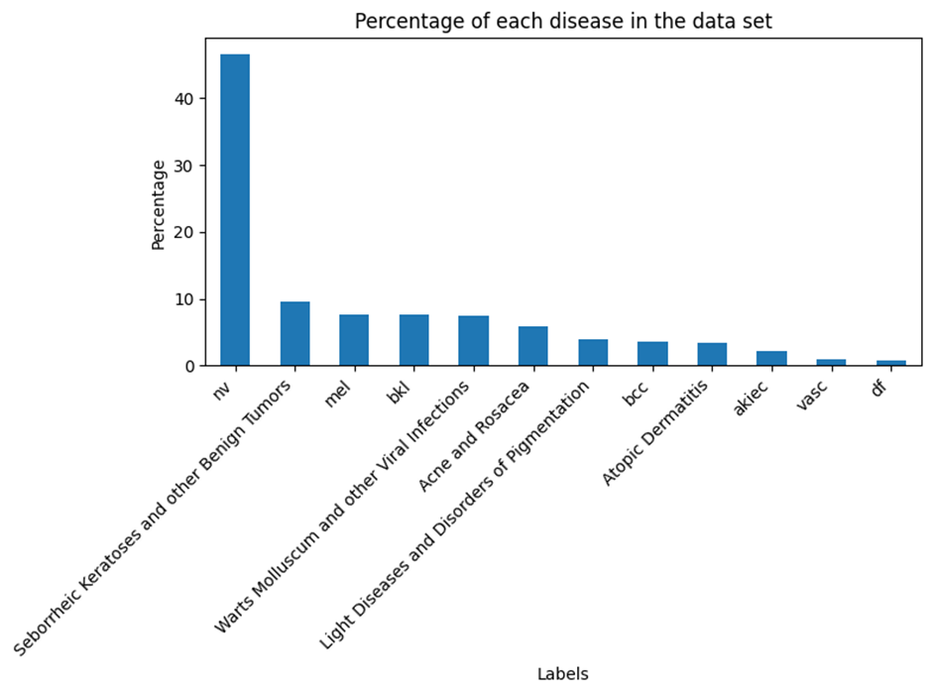
AI Model Results(cont)
Data before augmentation:
Figure 1 - Data Before augmentation

Slide 12
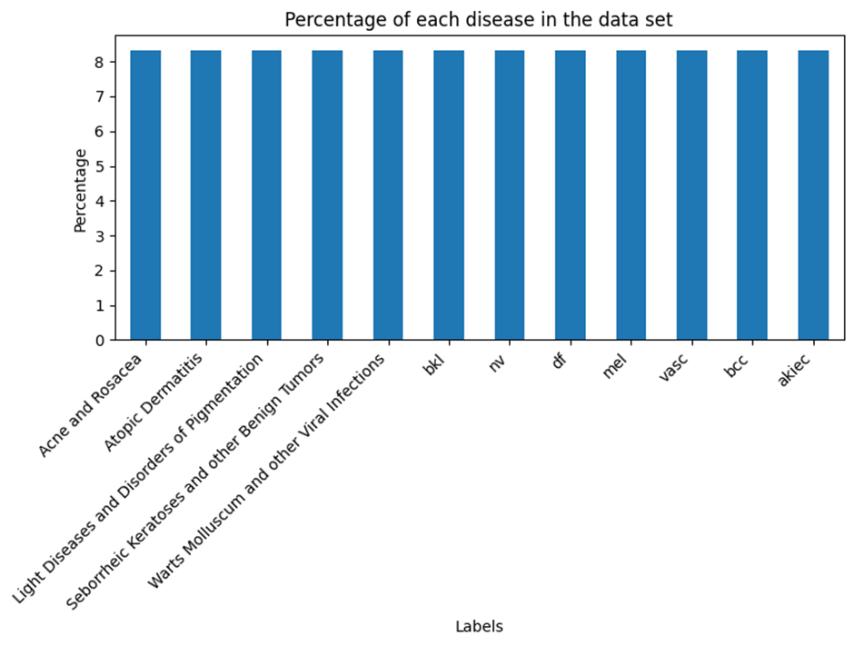
AI Model Results(cont)
Data after augmentation:
Figure 2 - Data After Augmentation

Slide 13
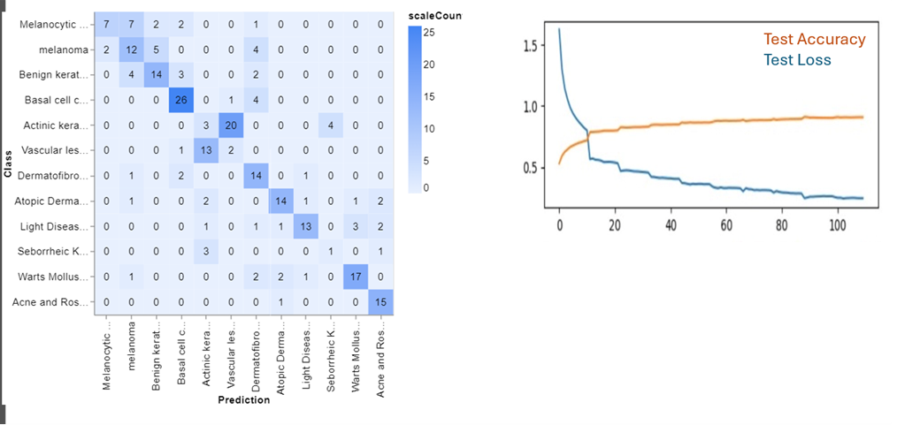
AI Model Results(Cont)
Performance metrics:
Figure 3 - Model Performance on Test Datasets

Slide 14
API Integration
Key Points:
- FastAPI for rapid execution and security.
- Preprocessing images for consistent predictions.
- Server deployment for real-time diagnostics.

Slide 15
Mobile Application Development
Framework:
Flutter for cross-platform development.
Benefits:
Consistent experience across iOS and Android, high performance, regular updates from Google.

Slide 16
Firebase Authentication and Storage
Firebase Authentication:
- Secure user login and authentication.
- Supports multiple authentication methods (email/password, Google).
Firebase Storage:
- Secure and scalable image storage.
- Efficient data management and retrieval.
- Integrated with Firebase Database for seamless data flow.

Slide 17
Firebase Firestore Database
Firebase Firestore Database:
- The database structure ensure efficient data flow .
- Quick access to information.
-Storing user data, images, and diagnosis results .
-Secure and accessible storage enhances user experience.

Slide 18
Firebase Firestore Database Structure
Patients
Dermatologists
Volunteer Data
Patient History
-Patient ID
Dermatologist History
-Dermatologist ID
Predictions
Diagnosis

Slide 19
Mobile Application Results
User Authentication:
Secure login for patients and dermatologists.
Patient Diagnosis Process:
Image capture, AI analysis, AI diagnosis with health reports, validation by local dermatologists, clinic visibility.
Dermatologist Interface:
Diagnosis verification, volunteered data verification.

Slide 20
Conclusions
Advancements: Significant advancements in dermatological care through AI and mobile technology.
Accessibility: Provides patients with access to timely medical insights.
Efficiency: Embraces technology for efficient and effective healthcare delivery.

Slide 21
Future Work
Expansion: Extend to iOS using Flutter’s capabilities.
Model Improvement: Use volunteered data to train and refine the AI model.
Increased Participation: Encourage more dermatologists and clinics to participate.
Infrastructure Upgrades: Enhance server infrastructure for faster deployment.

Slide 22
Acknowledgments
Gratitude Thanks to Allah, our families, friends,
and Prof. Iyad Jafar for the support and guidance.
Department Support Appreciation to the Computer Engineering department and all esteemed professors and engineers.

